Slide 1
CPS技术与创客实践 Ch02 Arduino 平台 Part A 传感器使用

Slide 2
Arduino
Arduino简介

Slide 3
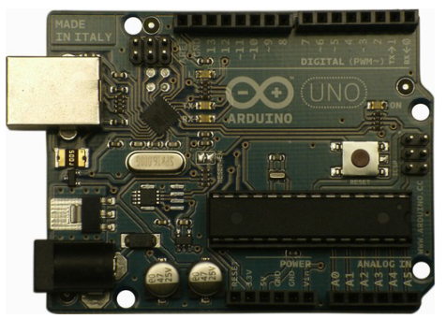
Arduino
Arduino 来源于意大利语，含义为“strong friend.”
Notes:
Figure 1-1. The Arduino I/O Board. This is what most people think of when you say “Arduino,” even
though it’s only one piece of a larger system.

Slide 4
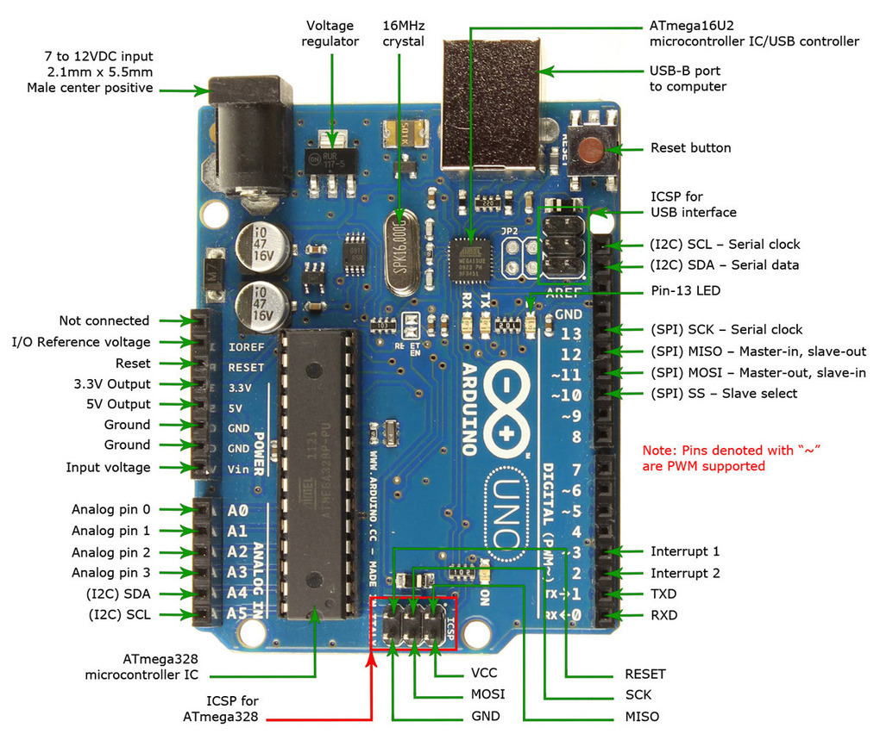
电源
In-Circuit Serial
Programming
USB通讯和供电
嵌入式系统
晶振
微控制器
数字接口
模拟接口

Slide 5
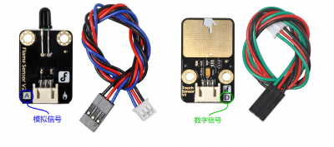
模拟/数字 部件

Slide 6
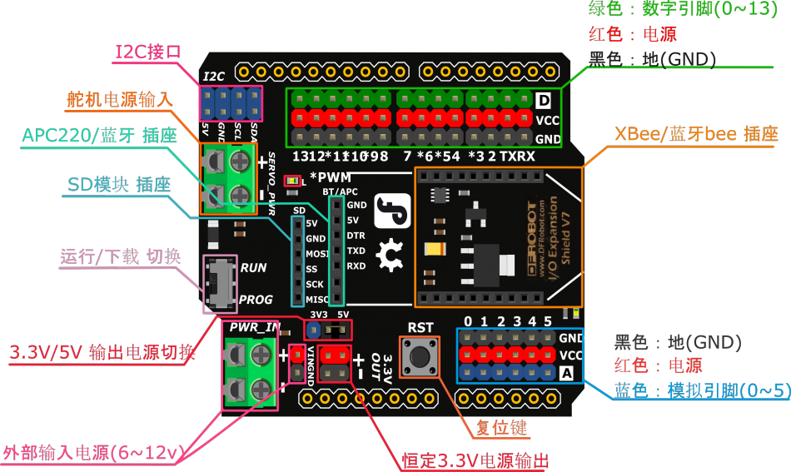
IO 扩展板

Slide 7
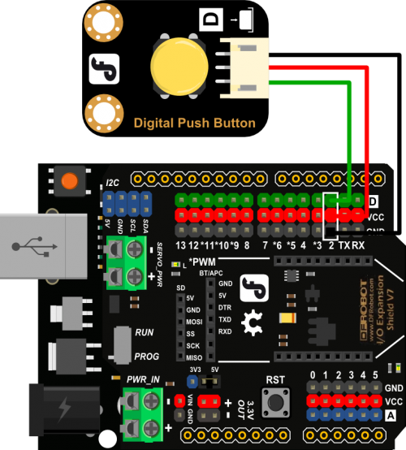
传感器连接

Slide 8
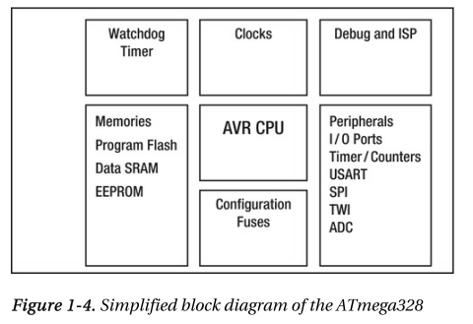
Atmega328
Atmel AVR

Slide 9
Arduino Uno接口引脚
接口引脚
Digital pins: 数字引脚，共14个（0-13）。可设置输入或输出（INPUT and OUTPUT）, 其取值只能为高和低（HIGH or LOW）.
Analog pins: 模拟输入引脚，共6个（A0 - A5），取值可在 0 到 1023 之间.
PWM pins: 脉冲宽度调制输出，（可作为模拟输出）
USB connector: USB接头，连接PC，
给开发板供电，
上传代码，
通过串口监控软件接收记录信息。
Notes:
接口引脚
Digital pins: 数字引脚，共14个（0-13）。可设置输入或输出（INPUT and OUTPUT）, 其取值只能为高和低（HIGH or LOW）.
Analog pins: 模拟输入引脚，共6个（A0 - A5），取值可在 0 到 1023 之间.
USB connector: USB接头，连接PC，给开发板供电，上传代码，通过串口监控软件接收记录信息。
Battery power: 电池供电。

Slide 10
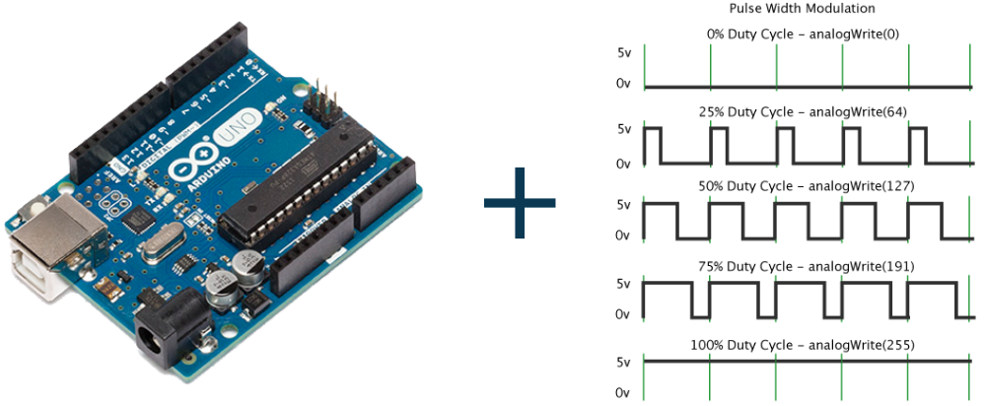
PWM
Pulse Width Modulation, or PWM

Slide 11
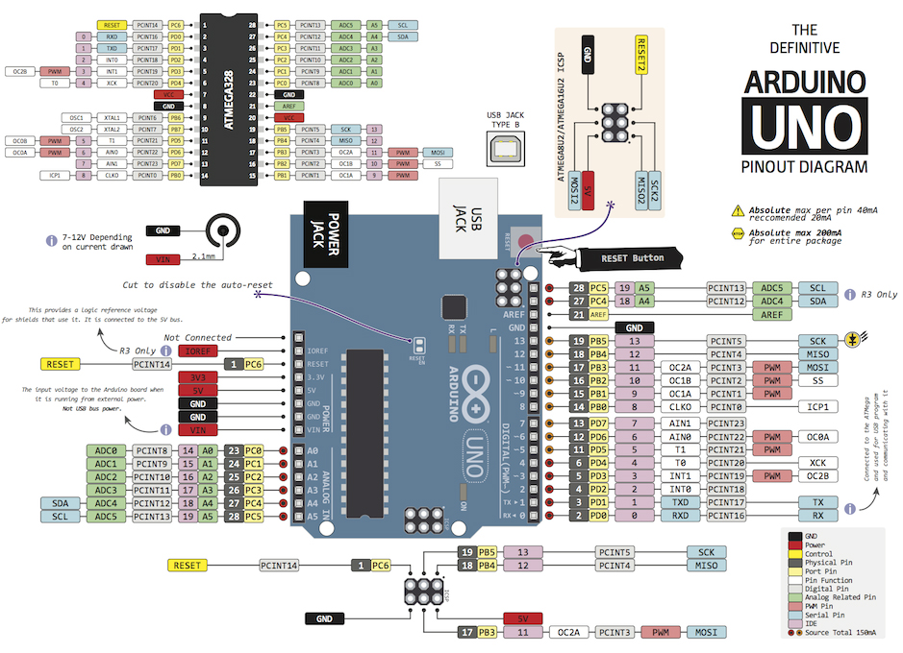
专用功能
PWM输出
模拟输入（引脚名）
数字输出（引脚名）
数字输出（引脚名）
Notes:
Arduino 结构框图

Slide 12
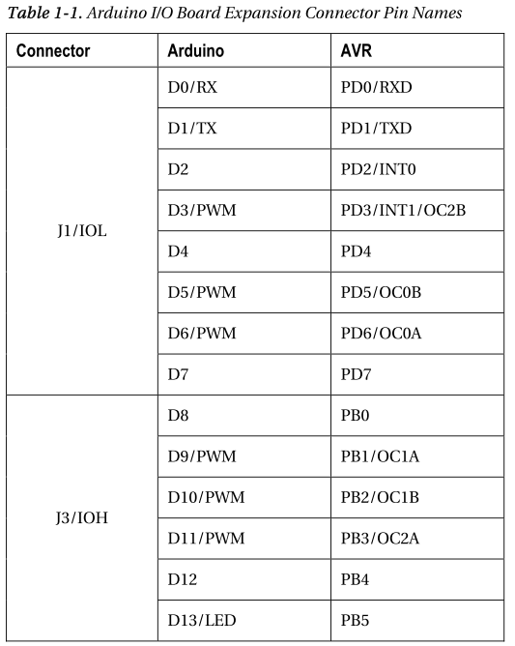
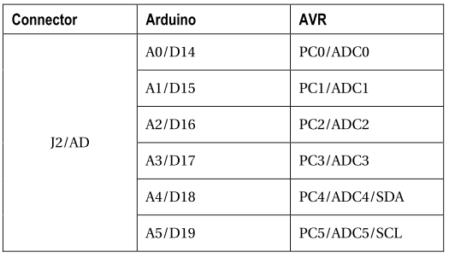
Pins

Slide 13
Arduino
IDE of Arduino

Slide 14
主机和目标
进行嵌入式开发，用到两个计算机：
PC 称为 host computer, 用来进行源代码编辑和编译
Arduino 称为 target computer，用来进行目标代码的运行.
这种开发方式通常称为交叉编译（ cross development ）。

Slide 15
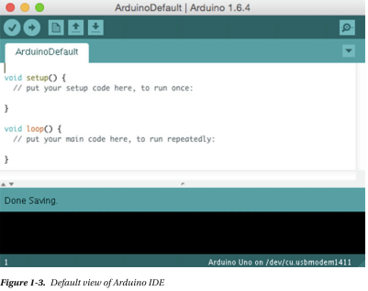
Arduino IDE
工具栏
打开串口监控窗口
除了代码编辑窗口 IDE 还有3个部分
• 工具栏，Toolbar
• 状态窗口，Status window
• 串口监控窗口，Serial Monitor window
状态窗口

Slide 16

工具栏
工具栏用于进行相关操作
Verify/Compile: 验证和编译按钮，编译时提示的信息在下方的状态窗口中显示。
Upload: 上传按钮，当Arduino开发板和PC机相连时，会将编译完成的代码上传到 Arduino 开发板，相关信息会在在下方的状态窗口中显示。
New/Open/Save: 这3个按钮实现新建/打开/保存文件操作. Arduino 代码文件名为 *.ino.
Serial/Monitor: 串口监控按钮，在工具栏的最右侧的。用于打开串口监控窗口

Slide 17
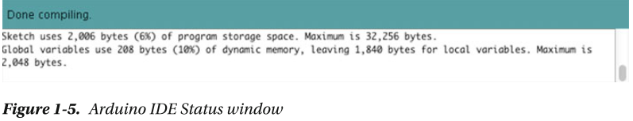
状态栏
状态栏用于显示提示信息

Slide 18
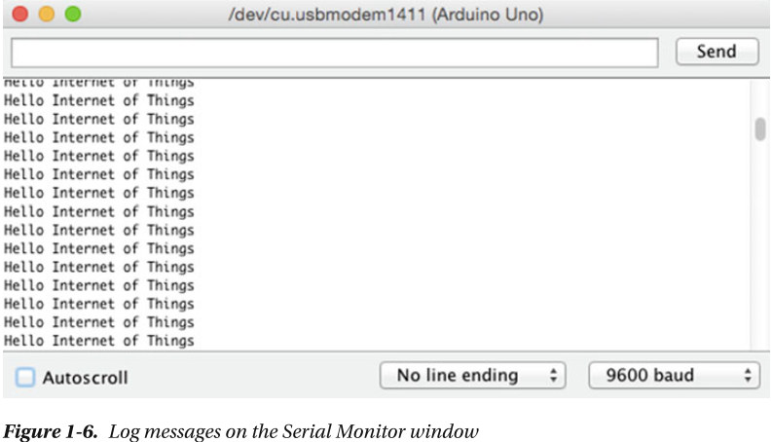
串口监控窗口
通过USB（转串口），进行字串输入/输出

Slide 19
Arduino
Arduino
代码设计

Slide 20
Arduino 代码框架
// 进行一次性的初始化操作
void setup()
{
}
// 重复执行的代码
void loop()
{
}

Slide 21
框架伪代码
void setup(void); // setup() function prototype
void loop(void); // loop() function prototype
int main(void)
{
setup();
while(1)
{
loop();
}
return 0; // this never happens
}
Notes:
C:\Program Files (x86)\Arduino\hardware\arduino\avr\cores\arduino\main.cpp

Slide 22
代码结构
一般分为3各部分:
External libraries: 引用所有需要代码库的头文件。
Constants and variables : 定义全局常量和变量
Functions : 实现所有自定义函数

Slide 23
代码结构
External libraries
#include <dht11.h>
#define DHT11_PIN 4
dht11 DHT;
void setup(){
Serial.begin(9600);
}
Constants and variables
Functions
void loop(){
int chk;
chk = DHT.read(DHT11_PIN);
if(chk== DHTLIB_OK){
Serial.print(DHT.humidity,1); //小数位数
Serial.print(",\t");
Serial.println(DHT.temperature,1);
}
delay(1000);
}
Notes:
语法：
Serial.print(val)
Serial.print(val, format)
参数：
val: 要发送的数据（任何数据类型）
format: 指定数字的基数（用于整型数）或者小数的位数（用于浮点数）。

Slide 24
Syntax
(自学)

Slide 25
Syntax
// (Single line comment): It is often useful to write notes to yourself as you go along about what each line of code does. To do this type two forward slashes at the beginning of your comment and everything until the end of the line will be ignored by your program.
/* */ (Multi line comment) :If you have a lot to say you can span several lines as a comment. Everything between these two symbols will be ignored in your program.

Slide 26
Syntax
; (Semicolon): Each line of code must be ended with a semicolon (a missing semicolon is often the reason for a program refusing to compile).
{ } (Curly brackets): Used to define when a block of code starts and ends (used in control structures as well as loops).

Slide 27
Constant
&
Variable

Slide 28
Constants
TRUE / FALSE: These are Boolean constants that define logic levels. FALSE is easily defined as (zero) while TRUE is often defined as 1;
HIGH / LOW: These constants define pin levels as HIGH or LOW and are used when reading or writing to digital pins. HIGH is defined as logic level 1 , ON, or 5 volts while LOW is logic level 0, OFF, or volts.
INPUT / OUTPUT : Constants used with the pinMode() function to define the mode of a digital pin as either INPUT or OUTPUT.

Slide 29
Constants
A0 – A7
Constants for analog pins; varies by board
0 – 13
Value for digital pins; varies by board

Slide 30
Data Types
int (integer):The main workhorse; stores a number in 2 bytes (16bits).
long (long):Used when an integer is not large enough. Takes 4 bytes (32 bits) of RAM.
boolean / bool (Boolean):A simple True or False variable.
float (float):Used for floating point math (decimals). Takes 4 bytes (32 bits) of RAM.
char (character):Stores one character using the ASCII code (ie ‘A’ = 65). Uses one byte (8 bites) of RAM. The Arduino handles strings as an array of char’s.

Slide 31
Variable Scope
A global variable is one that can be seen and used by every function and statement in a program. This variable is declared at the beginning of the program, before the setup() function.
A local variable is one that is defined inside a function or as part of a for loop. It is only visible and can only be used inside the function in which it was declared.

Slide 32
Operations

Slide 33
3.2 Arithmetic operators
Operator Meaning
＋ Addition or unary plus
－ Subtraction or unary minus
＊ Multiplication
／ Division
％ Modulo division
Examples:
a-b, a+b, a*b, a/b, a%b
Notes:
modulo英['mɒdjʊləʊ]美['mɒdjəˌloʊ]
prep.模数; 以…为模;

Slide 34
3.3 Relational Operators
C supports six relational operators in all:
Operators Meaning
< is less than
<= is less than or equal to
> is greater than
>= is greater than or equal to
== is equal to
!= is not equal to
Example
4.5<=10 4.5<-10 -35>=0
10<7+5 a+b=c+d ?

Slide 35
3.4 Logical Operators
C has the following three logical operators:
&& meaning logical AND
|| meaning logical OR
! meaning logical NOT

Slide 36
Assignment Operators
Simple assignment: used for storing a value into a variable
Compound assignment: used for updating a value already stored in a variable
=

Slide 37
3.5 Assignment Operators
op=
Shorthand assignment operator
Compound assignment operator
v op= exp;
is equivalent to
v = v op (exp);
Examples:
x+=y+1; is equivalent to x=x+(y+1);
x+=3; is equivalent to x=x+3;
Do not add space between op and =

Slide 38
Statements

Slide 39
Statements
Most of C’s remaining statements fall into three categories:
Selection statements: if and switch
Iteration statements: while, do, and for
Jump statements: break, continue, and goto. (return also belongs in this category.)
Other C statements:
Compound statement
Null statement

Slide 40
Compound Statements
A compound statement has the form
{ statements }
Putting braces around a group of statements forces the compiler to treat it as a single statement.

Slide 41
The Null Statement
A statement can be null — devoid of symbols except for the semicolon at the end.
The following line contains three statements:
i = 0; ; j = 1;
The null statement is primarily good for one thing: writing loops whose bodies are empty.

Slide 42
The if Statement
Example:
if (line_num == MAX_LINES)
line_num = 0;
Example:
if (i > j)
max = i;
else
max = j;
Example:
if (i > j)
{
max = i;
}
else
{
max = j;
}

Slide 43
The switch Statement
Most common form of the switch statement:
switch ( expression )
{
case constant-expression :
statements
…
case constant-expression :
statements
default : statements
}
Notes:
Parentheses
bracket
brace

Slide 44
Loops

Slide 45
Iteration Statements
C provides three iteration statements:
The while statement is used for loops whose controlling expression is tested before the loop body is executed.
The do statement is used if the expression is tested after the loop body is executed.
The for statement is convenient for loops that increment or decrement a counting variable.

Slide 46
while ( expression )
statement
do statement while ( expression ) ;
for ( expr1 ; expr2 ; expr3 )
statement

Slide 47
break vs continue
In loop:
With break, control leaves the loop;
With continue, control remains inside the loop.
In switch:
break statement only.

Slide 48
Functions

Slide 49
Some Useful Functions
pinMode(pin, mode);
Used to set a pin’s mode, pin is the pin number you would like to address 0-13. The mode can either be INPUT or OUTPUT.

Slide 50
Some Useful Functions
digitalRead(pin)
Reads the value from a specified digital pin with the result either HIGH or LOW. The pin can be specified as either a variable or constant (0-13).

Slide 51
Some Useful Functions
digitalWrite(pin, value)
Ouputs either logic level HIGH or LOW at (turns on or off) a specified digital pin. The pin can be specified as either a variable or constant (0-13).

Slide 52
Some Useful Functions
analogRead(pin)
Reads the value from a specified analog pin with a 10-bit resolution. This function only works on the analog in pins (0-5). The resulting integer values range from 0 to 1023.
Note: Analog pins unlike digital ones, do not need to be first declared as INPUT nor OUTPUT.

Slide 53
Some Useful Functions
analogWrite(pin, value)
Writes a pseudo-analog value using hardware enabled pulse width modulation (PWM) to an output pin marked PWM.
On Arduinos with the ATmega168 chip, this function works on pins 3, 5, 6, 9, 10, and 11 .
The value can be specified as a variable or constant with a value from 0-255.

Slide 54
Some Useful Functions
delay(ms)
Pauses your program for the amount of time as specified in milliseconds, where 1000 equals 1 second.
min(x, y)
Calculates the minimum of two numbers of any data type and returns the smaller number.
max(x, y)
Calculates the maximum of two numbers of any data type and returns the larger number.

Slide 55
Some Useful Functions
Serial.begin(rate)
Opens serial port and sets the baud rate for serial data transmission. The typical baud rate for communicating with the computer is 9600 although other speeds are supported.
Serial.println(data) / Serial.print(data)
Serial.Read
return int value
Serial.Available
return TRUE or FALSE

Slide 56
Arduino
Arduino语言总结

Slide 57
常用类型
Code Construct | Description
int | Integer, 2 bytes (16bits).
long | Long, 4 bytes (32 bits)
boolean / bool | Boolean, A simple True or False variable.
float | Float: floating point value,4 bytes (32 bits)
char | Character,1 byte (8 bits)
char[ ] /string | String values, such as "Arduino"
Notes:
C:\Program Files (x86)\Arduino\hardware\arduino\avr\cores\arduino\Arduino.h

Slide 58
常用常量
Code Construct | Description
HIGH | Digital pin with current
LOW | Digital pin with no current
INPUT | Pin can only be read
OUTPUT | Pin can only be set
A0 – A7 | Constants for analog pins; varies by board
0 – 13 | Constants for digital pins; varies by board
Notes:
C:\Program Files (x86)\Arduino\hardware\arduino\avr\cores\arduino\Arduino.h

Slide 59
引脚函数
Code Construct | Description
analogRead() | Returns analog pin value (0 – 1023)
analogWrite(...) | Sets analog pin value
pinMode(…) | Sets digital pin mode (OUTPUT or INPUT)
digitalRead() | Returns digital pin value (HIGH or LOW)
digitalWrite(...) | Sets digital pin value (HIGH or LOW)

Slide 60
其它函数
Code Construct | Description
Serial.begin() | Initializes serial monitor
Serial.print() | Logs message on serial monitor
Serial.println() | Logs message on serial monitor with new line
delay(ms) | Adds a wait in processing

Slide 61
代码结构
Code Construct | Description
setup() | Standard Arduino function called once
loop() | Standard Arduino function called repeatedly
#define | Defines a constant
#include | Includes an external library
You can explore the complete language at https://www.arduino.cc/en/Reference .

Slide 62
IO 扩展板

Slide 63
模拟/数字 部件

Slide 64
Arduino
Arduino开发
-- 基础模块

Slide 65
Arduino 项目开发
项目创建与设置
启动 Arduino IDE，并输入代码
点击 Verify 按钮进行代码验证和编译
确保已用 USB 电缆连接了PC和开发板
选择 Tools ➤ Board 菜单，选择 Arduino Uno 菜单项(和开发板匹配).
选择 Tools ➤ Port 菜单，选择USB端口。
点击 Upload 按钮
打开Serial Monitor 窗口. 确保其设置和 Serial.begin() 函数的调用参数一致

Slide 66
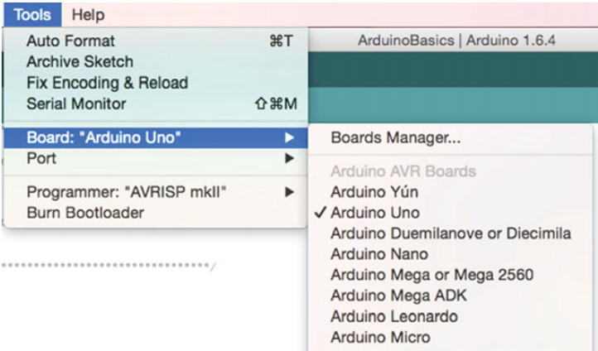
选择开发板

Slide 67
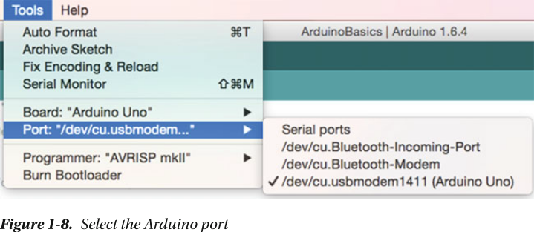
选择连接target的端口

Slide 68
Arduino
LED

Slide 69
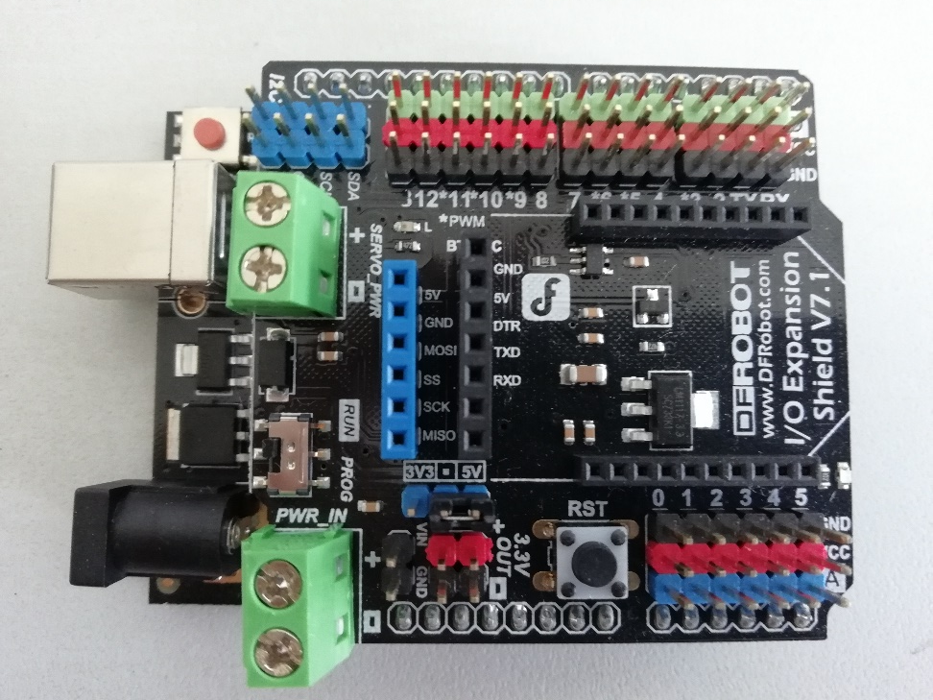
P02-Button （项目1）
连接
无。板上自带LED（连接至引脚13）
功能：
LED 循环点亮、熄灭，间隔时间1s。

Slide 70
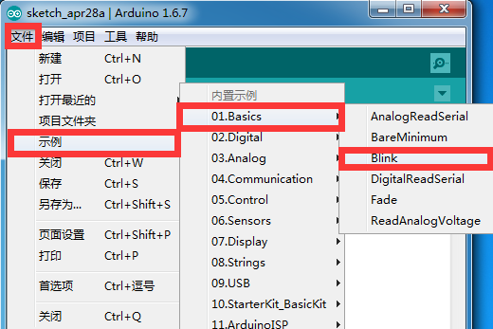
样例代码

Slide 71
Demo – LED flash
数字输出
#define LED 13
void setup() {
pinMode(LED, OUTPUT); // D13 to output
}
void loop() {
digitalWrite(LED, HIGH); // turn on the LED
delay(1000); // one-second delay
digitalWrite(LED, LOW); // turn off the LED
delay(1000); // one-second delay
}

Slide 72
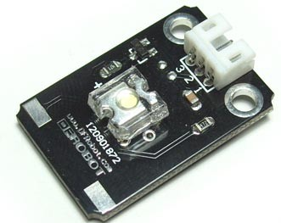
外接 LED 模块 （项目5）
连接
连接数字13脚
功能：
LED 循环点亮、熄灭，间隔时间1s。
Digital piranha LED light module v2

Slide 73
Arduino
实例代码

Slide 74
Arduino
Button

Slide 75
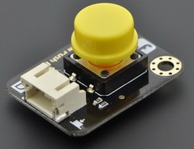
P02-Button （项目1）
连接
板子上的引脚13连接LED（板上自带）
按键扩展板连接到引脚2
功能：
按下按键时，板子上的13号引脚的LED将会被点亮，
松开后，灯熄灭。
Digital Push Button

Slide 76
Demo P02-Button
数字输入
int ledPin = 13; // LED引脚
int inputPin = 2; // 传感器引脚
void setup() {
pinMode(ledPin, OUTPUT); // LED引脚设置为输出
pinMode(inputPin, INPUT); // 按键引脚设置为输入
}
void loop(){
int val = digitalRead(inputPin); //读取输入值
if (val == HIGH) { // 检查输入 【按下=1】
digitalWrite(ledPin, HIGH); // 灯亮起状态
} else { 【松开=0】
digitalWrite(ledPin, LOW); // 灯关闭状态
}
}

Slide 77
Arduino
Button interrupt

Slide 78
P03-ButtonInt
连接
板子上的引脚13连接LED（板上自带）
按键扩展板连接到引脚2
功能：
中断方式实现
初次按键时，LED将会点亮 【输出(写)1】
再次按键时，LED 状态切换
点亮变为熄灭
熄灭变为点亮

Slide 79
P03-ButtonInt
int ledPin = 13; // LED的引脚
int inputPin = 2; // 传感器引脚
int val=0;
void setup() {
pinMode(ledPin, OUTPUT); // LED引脚为输出引脚
pinMode(inputPin, INPUT); // LED按键引脚为输入
attachInterrupt(0, ledOnOff, RISING);
//0 =>D2,1=>D3
}
void loop(){
}
中断号
中断服务函数
触发方式
在大多数arduino上有以下四种触发方式： LOW 低电平触发 CHANGE 电平变化，高电平变低电平、低电平变高电平 RISING 上升沿触发 FALLING 下降沿触发 HIGH 高电平触发(该中断模式仅适用于Arduino due)

Slide 80
可用中断
Notes:
Arduino 结构框图

Slide 81
-- 中断处理函数
void ledOnOff(){
val=!val;
if (val == HIGH) { // 确定所需输出
digitalWrite(ledPin, HIGH); // 灯亮起状态
} else {
digitalWrite(ledPin, LOW); // 灯关闭状态
}
}

Slide 82
Arduino
Serial

Slide 83
P03-ButtonInt
连接
连接USB下载线
功能：
通过PC上的串口监视器查看Ardunio的输出信息

Slide 84
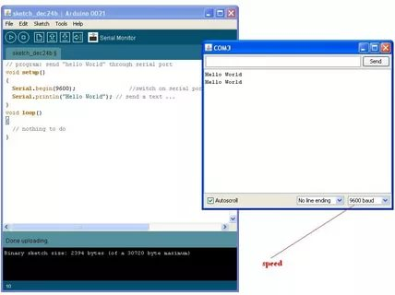
Demo- Hello, world
串口输出
void setup() {
Serial.begin(9600);
Serial.println("Hello, world!");
}
void loop() {
}

Slide 85
Arduino
LightSensor

Slide 86
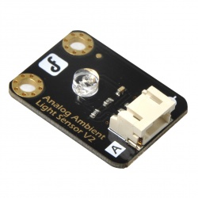
P05-LightSensor （项目9）
模拟输入
连接
光敏传感器接到模拟输入引脚A0
功能：
打开PC上串口监视器可以查看来自Ardunio的光敏传感器的值
Analog Ambient Light Sensor V2.1

Slide 87
P05-LightSensor
void setup(){
Serial.begin(9600); // 波特率9600 bps
}
void loop()
{
int val;
val=analogRead(0); //读取A0脚的输入值
Serial.println(val,DEC);//转换为字串并输出
delay(100);
}

Slide 88
Arduino
LED 光强控制

Slide 89
P02-Button （项目1）
模拟输出
连接
LED扩展板连接到引脚10
功能：
LED 亮度随时间变化，逐渐由暗变亮，由亮变暗。
Digital piranha LED light module v2

Slide 90
项目5
PWM pins 3, 5, 6, 9, 10, and 11
int ledPin = 10;
void setup() {
pinMode(ledPin,OUTPUT);
}
void loop(){
for (int value = 0 ; value < 255; value++){
analogWrite(ledPin, value);
delay(5);
}
//…
}
for (int value = 255; value >0; value--){
analogWrite(ledPin, value);
delay(5);
}

Slide 91
Arduino
直流电机控制

Slide 92
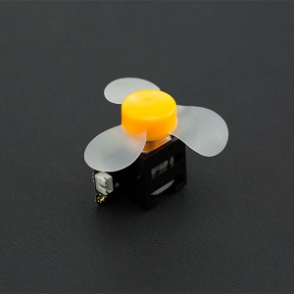
项目18
模拟输出
连接
电机风扇模块连接到引脚10
功能：
电机风扇速度随时间变化，逐渐由慢变快，由快变慢。
代码和光强控制代码基本相同
(SKU:DFR0411)130 DC Motor pack电机风扇模块

Slide 93
Arduino
DTH11 Library
(3rd lib)

Slide 94
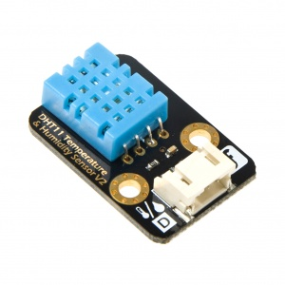
B5_DHT11Lib
软件
安装DHT11库
连接
DHT11模块连接引脚4
功能
通过dht11库，读取温度值
通过串口显示

Slide 95
B5_DHT11Lib
#include <dht11.h>
#define DHT11_PIN 4
dht11 DHT; //定义DHT温湿度变量
void setup(){
Serial.begin(9600);
}
void loop(){
int chk;
chk = DHT.read(DHT11_PIN);
if(chk== DHTLIB_OK){
Serial.print(DHT.humidity,1); //小数位数
Serial.print(",\t");
Serial.println(DHT.temperature,1);
}
delay(1000);
}
Notes:
语法：
Serial.print(val) Serial.print(val, format) 参数：
val: 要发送的数据（任何数据类型） format: 指定数字的基数（用于整型数）或者小数的位数（用于浮点数）。

Slide 96
Arduino
Arduino
库安装

Slide 97
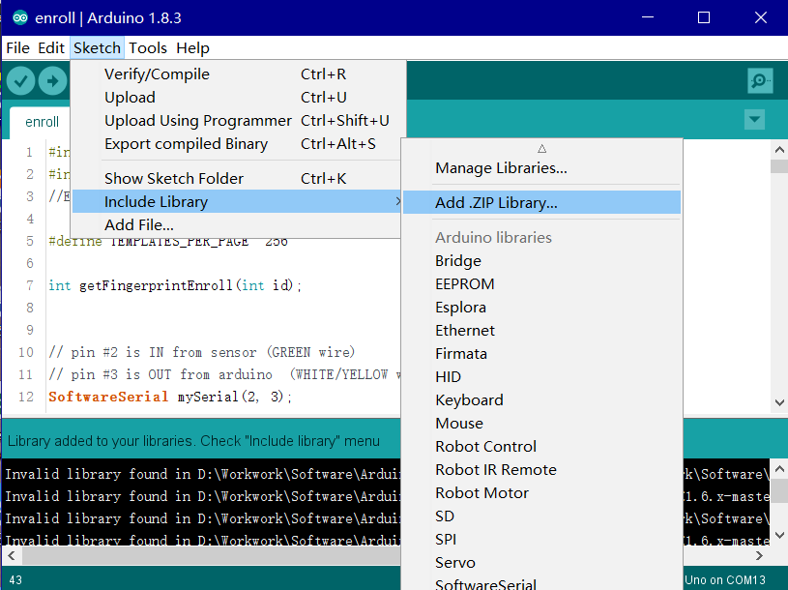
方法一：IDE中安装

Slide 98
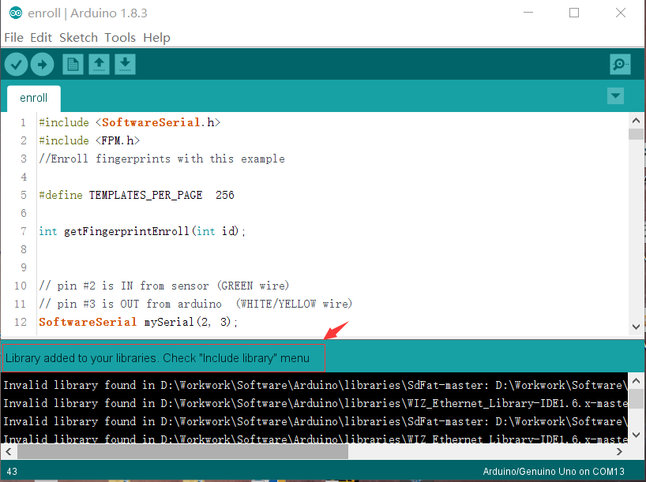

Slide 99
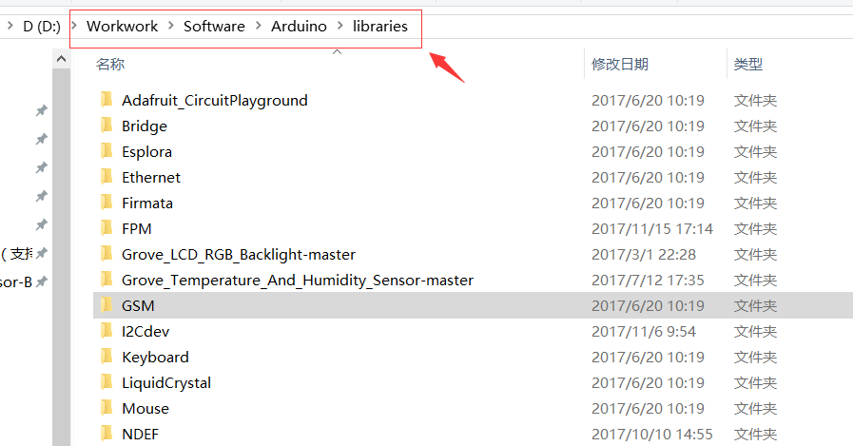
方法二：直接解压到目录
需重启IDE
C:\Program Files (x86)\Arduino\libraries
任选一个
C:\Users\steven\Documents\Arduino\libraries\

Slide 100
示例代码的使用
库中一般自带示例，当库代码相关文件正确安装后，
可使用 File > Example > 菜单找到对应的例子

Slide 101
Arduino
Servo Library
(system lib)

Slide 102
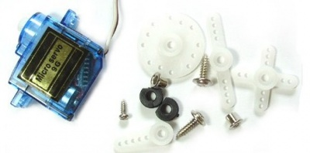
P10-Servo
软件
内置Servo库
连接
Servo模块连接PWM输出引脚9
描述：
舵机控制，正向180，反向180

Slide 103
P10-Servo
#include <Servo.h> // 声明调用Servo.h库
Servo myservo; // 创建一个舵机对象
int pos = 0; // 变量pos用来存储舵机位置
void setup() {
myservo.attach(9);// 将引脚9上的舵机与声明的舵机对象连接起来
}
void loop() {
for(pos = 0; pos < 180; pos += 1){ // 0-180，每次1
myservo.write(pos); // 给舵机写入角度
delay(15); // 延时15ms
}
for(pos = 180; pos>=1; pos-=1) { // 180-0，每次1°
myservo.write(pos); // 写角度到舵机
delay(15); // 延时15ms让舵机转到指定位置
}
}
Notes:
语法：
Serial.print(val) Serial.print(val, format) 参数：
val: 要发送的数据（任何数据类型） format: 指定数字的基数（用于整型数）或者小数的位数（用于浮点数）。

Slide 104
Arduino
LCD Library
（3rd Lib）

Slide 105
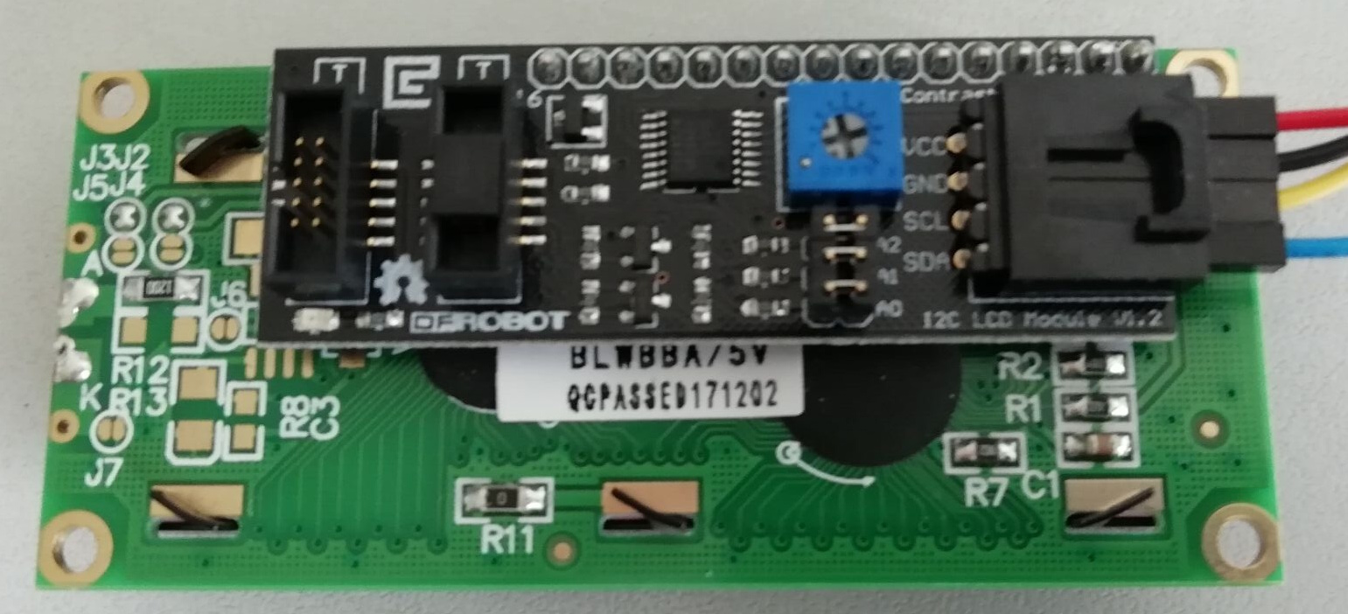
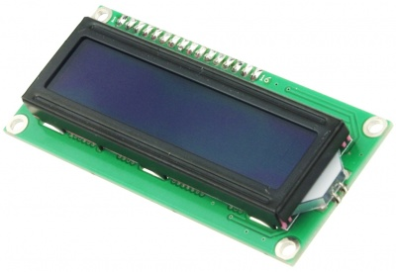
LCD
连接
连接LCD SDA的引脚，到A4（I2C 功能脚）
连接LCD SCL的引脚，到A5（I2C 功能脚）
连接VCC
连接GND
描述：
在液晶屏上显示字串

Slide 106
Demo -- LCD string
#include <LiquidCrystal_I2C.h>
LiquidCrystal_I2C lcd(0x20,16,2);
// address:0x20,2 rows，16 columns
void setup(){
lcd.init();
lcd.backlight();
lcd.setCursor(0,1); //row 0, col 1
lcd.print("Arduino ");
}
void loop(){}

Slide 107
Demo -- LCD int
int x=0;
void loop(){
lcd.setCursor(0,0);
lcd.print(x);
x++;
delay(1000);
}

Slide 108
Thank You！

